Slide 1
Dantzig-Wolfe (DW) Decomposition
Prepared by Daniel Zuniga
For Walmart Interview
IP Formulation
Unbounded LP Formulation
Daniel Zuniga
Dantzig-Wolfe Decomposition
Sep. 19, 2021 Slide 1 of .
21

Slide 2
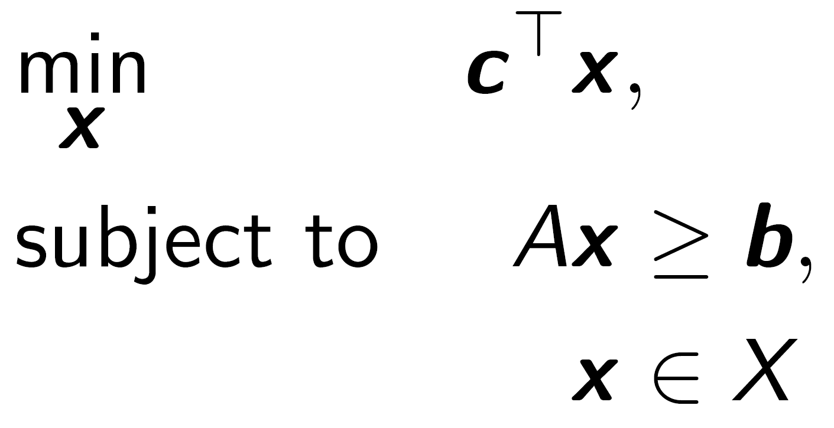
Dantzig-Wolfe (DW) Decomposition
IP Formulation
Consider the following IP problem
s.t.
Daniel Zuniga
Dantzig-Wolfe Decomposition
Sep. 19, 2021 Slide 2 of .
21

Slide 3
Dantzig-Wolfe (DW) Decomposition
IP Formulation
Consider the following IP problem.
From the Representation Theorem, any feasible point can be obtained by a convex combination.
s.t.
Convex combination
Daniel Zuniga
Dantzig-Wolfe Decomposition
Sep. 19, 2021 Slide 3 of .
21

Slide 4
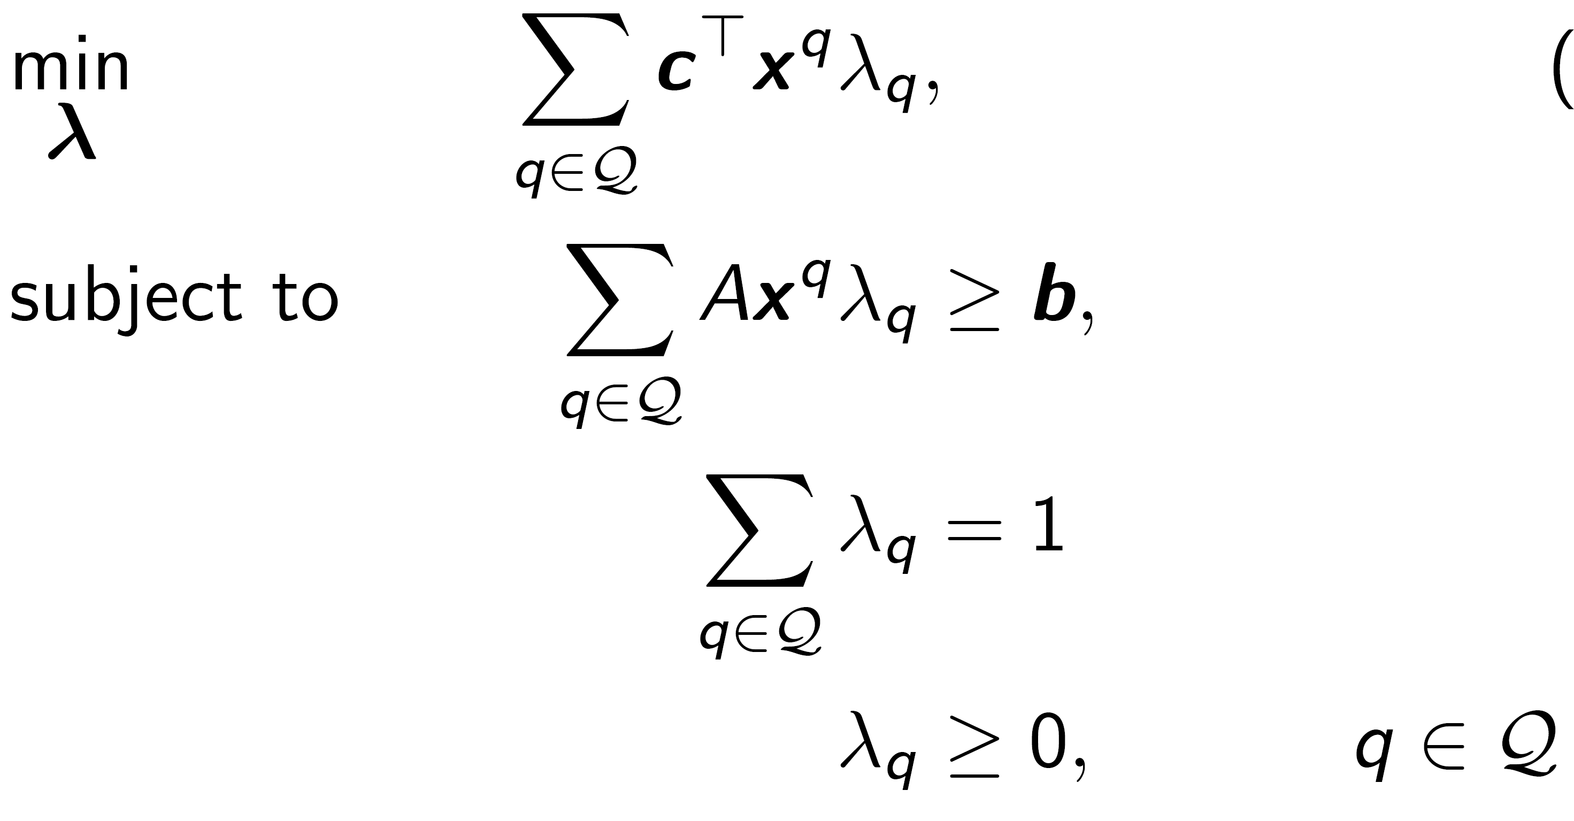
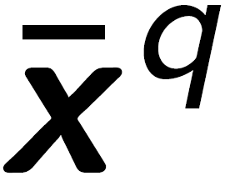
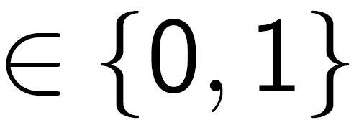
Dantzig-Wolfe (DW) Decomposition
IP Formulation
Master Problem DW Reformulation
Consider the following IP problem.
From the Representation Theorem, any feasible point can be obtained by a convex combination.
Can obtain the master problem DW reformulation.
s.t.
Convex combination
s.t.
Daniel Zuniga
Dantzig-Wolfe Decomposition
Sep. 19, 2021 Slide 4 of .
21

Slide 5
Dantzig-Wolfe (DW) Decomposition
IP Formulation
Master Problem DW Reformulation
Consider the following IP problem.
From the Representation Theorem, any feasible point can be obtained by a convex combination.
Can obtain the master problem DW reformulation.
The extreme points are indicated by .
s.t.
Convex combination
s.t.
Extreme points
Daniel Zuniga
Dantzig-Wolfe Decomposition
Sep. 19, 2021 Slide 5 of .
21

Slide 6
Dantzig-Wolfe (DW) Decomposition
IP Formulation
Master Problem DW Reformulation
Consider the following IP problem.
From the Representation Theorem, any feasible point can be obtained by a convex combination.
Can obtain the master problem DW reformulation.
The extreme points are indicated by .
We can get the LP relaxation of the master problem.
s.t.
Convex combination
s.t.
LP relaxation
Daniel Zuniga
Dantzig-Wolfe Decomposition
Sep. 19, 2021 Slide 6 of .
21

Slide 7
Dantzig-Wolfe (DW) Decomposition
IP Formulation
Master Problem DW Reformulation
Consider the following IP problem.
From the Representation Theorem, any feasible point can be obtained by a convex combination.
Can obtain the master problem DW reformulation.
The extreme points are indicated by .
We can get the LP relaxation of the master problem.
The reformulation has fewer constraints but many more variables.
s.t.
Convex combination
Very large number of variables
s.t.
Daniel Zuniga
Dantzig-Wolfe Decomposition
Sep. 19, 2021 Slide 7 of .
21

Slide 8

Dantzig-Wolfe (DW) Decomposition
IP Formulation
Restricted Master Problem DW Reformulation
Consider the following IP problem.
From the Representation Theorem, any feasible point can be obtained by a convex combination.
Can obtain the master problem DW reformulation.
The extreme points are indicated by .
We can get the LP relaxation of the master problem.
The reformulation has fewer constraints but many more variables.
The restricted master problem (RMP) is obtained by dropping all but a subset of columns .
s.t.
Convex combination
s.t.
Daniel Zuniga
Dantzig-Wolfe Decomposition
Sep. 19, 2021 Slide 8 of .
21

Slide 9

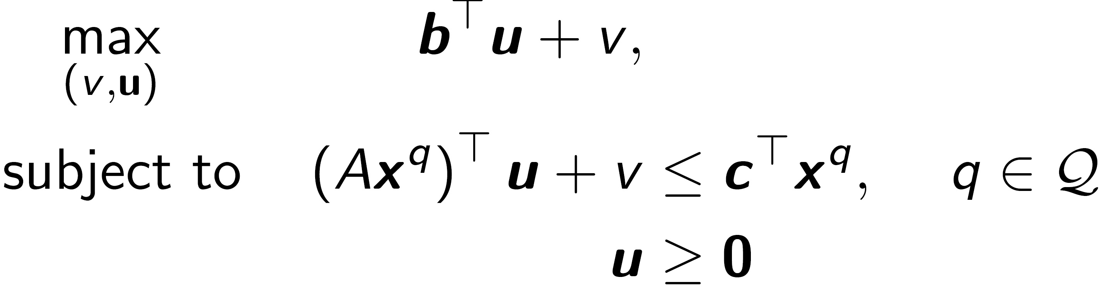
Dantzig-Wolfe (DW) Decomposition
IP Formulation
Restricted Master Problem DW Reformulation
Consider the following IP problem.
From the Representation Theorem, any feasible point can be obtained by a convex combination.
Can obtain the master problem DW reformulation.
The extreme points are indicated by .
We can get the LP relaxation of the master problem.
The reformulation has fewer constraints but many more variables.
The restricted master problem (RMP) is obtained by dropping all but a subset of columns .
Given the dual variables, the dual of the LP master problem can be obtained.
s.t.
Convex combination
s.t.
Dual of the LP Master Problem
s.t.
Daniel Zuniga
Dantzig-Wolfe Decomposition
Sep. 19, 2021 Slide 9 of .
21

Slide 10
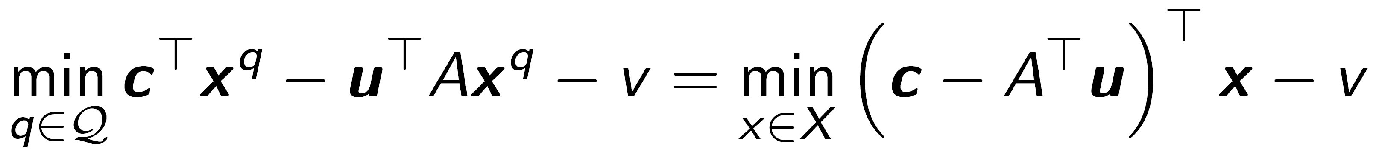
Dantzig-Wolfe (DW) Decomposition
IP Formulation
Restricted Master Problem DW Reformulation
Consider the following IP problem.
From the Representation Theorem, any feasible point can be obtained by a convex combination.
Can obtain the master problem DW reformulation.
The extreme points are indicated by .
We can get the LP relaxation of the master problem.
The reformulation has fewer constraints but many more variables.
The restricted master problem (RMP) is obtained by dropping all but a subset of columns .
Given the dual variables, the dual of the LP master problem can be obtained.
Due to the Simplex Method, we need to find the most negative reduced cost (incoming column).
s.t.
Convex combination
s.t.
Dual of the LP Master Problem
s.t.
Most Negative Reduced Cost
Daniel Zuniga
Dantzig-Wolfe Decomposition
Sep. 19, 2021 Slide 10 of .
21

Slide 11
Dantzig-Wolfe (DW) Decomposition
IP Formulation
Restricted Master Problem DW Reformulation
Consider the following IP problem.
From the Representation Theorem, any feasible point can be obtained by a convex combination.
Can obtain the master problem DW reformulation.
The extreme points are indicated by .
We can get the LP relaxation of the master problem.
The reformulation has fewer constraints but many more variables.
The restricted master problem (RMP) is obtained by dropping all but a subset of columns .
Given the dual variables, the dual of the LP master problem can be obtained.
Due to the Simplex Method, we need to find the most negative reduced cost (incoming column).
If reduced cost ≥ 0
If optimal solution is integer, we are done.
Else solve among the columns generated to find one.
Else add new column
s.t.
Convex combination
s.t.
Dual of the LP Master Problem
s.t.
Most Negative Reduced Cost
Daniel Zuniga
Dantzig-Wolfe Decomposition
Sep. 19, 2021 Slide 11 of .
21

Slide 12
Dantzig-Wolfe (DW) Decomposition
IP Formulation
Unbounded LP Formulation
Daniel Zuniga
Dantzig-Wolfe Decomposition
Sep. 19, 2021 Slide 12 of .
21

Slide 13
Dantzig-Wolfe (DW) Decomposition
Unbounded LP Formulation
Consider the following unbounded LP problem.
s.t.
Daniel Zuniga
Dantzig-Wolfe Decomposition
Sep. 19, 2021 Slide 13 of .
21

Slide 14
Dantzig-Wolfe (DW) Decomposition
Unbounded LP Formulation
Consider the following unbounded LP problem.
From the Representation Theorem, any feasible point can be obtained by a convex combination.
Convex combination
s.t.
Daniel Zuniga
Dantzig-Wolfe Decomposition
Sep. 19, 2021 Slide 14 of .
21

Slide 15
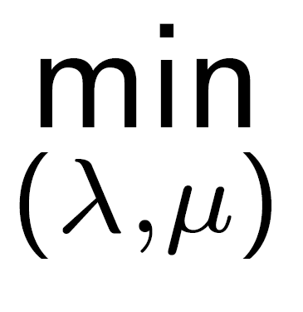
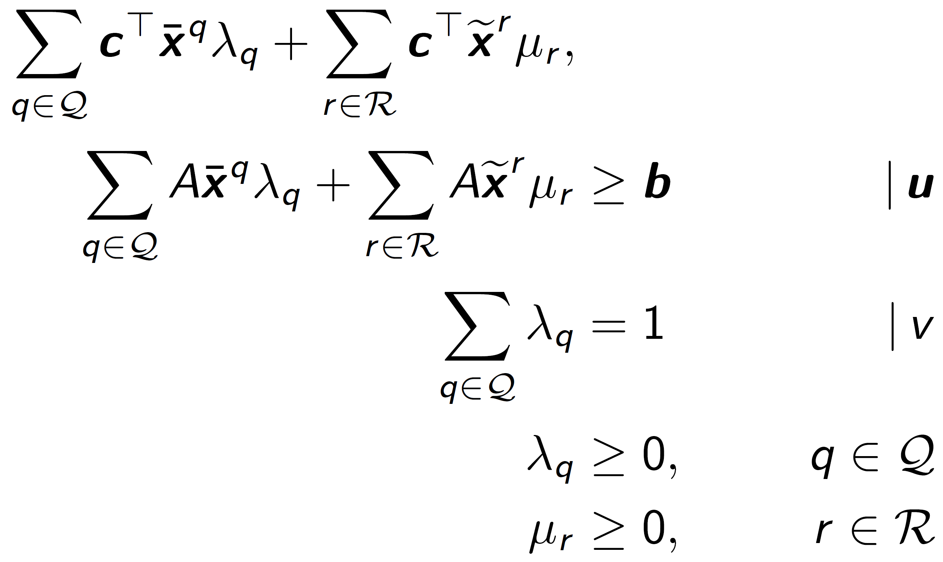
Dantzig-Wolfe (DW) Decomposition
Unbounded LP Formulation
Master Problem DW Reformulation
Consider the following unbounded LP problem.
From the Representation Theorem, any feasible point can be obtained by a convex combination.
Can obtain the master problem DW reformulation.
Convex combination
s.t.
s.t.
Daniel Zuniga
Dantzig-Wolfe Decomposition
Sep. 19, 2021 Slide 15 of .
21

Slide 16
Dantzig-Wolfe (DW) Decomposition
Unbounded LP Formulation
Master Problem DW Reformulation
Consider the following unbounded LP problem.
From the Representation Theorem, any feasible point can be obtained by a convex combination.
Can obtain the master problem DW reformulation.
Here we have:
A convex combination of extreme points .
A conic combination of extreme rays .
Convex combination
s.t.
s.t.
Extreme points
Extreme rays
Daniel Zuniga
Dantzig-Wolfe Decomposition
Sep. 19, 2021 Slide 16 of .
21

Slide 17
Dantzig-Wolfe (DW) Decomposition
Unbounded LP Formulation
Master Problem DW Reformulation
Consider the following unbounded LP problem.
From the Representation Theorem, any feasible point can be obtained by a convex combination.
Can obtain the master problem DW reformulation.
Here we have:
A convex combination of extreme points .
A conic combination of extreme rays .
The reformulation has fewer constraints but many more variables.
Convex combination
s.t.
s.t.
Very large number of variables
Daniel Zuniga
Dantzig-Wolfe Decomposition
Sep. 19, 2021 Slide 17 of .
21

Slide 18
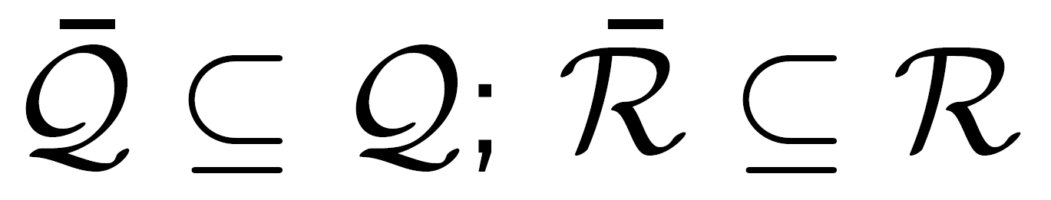
Dantzig-Wolfe (DW) Decomposition
Unbounded LP Formulation
Restricted Master Problem DW Reformulation
Consider the following unbounded LP problem.
From the Representation Theorem, any feasible point can be obtained by a convex combination.
Can obtain the master problem DW reformulation.
Here we have:
A convex combination of extreme points .
A conic combination of extreme rays .
The reformulation has fewer constraints but many more variables.
The restricted master problem (RMP) is obtained by dropping all but a subset of columns and .
Convex combination
s.t.
s.t.
Daniel Zuniga
Dantzig-Wolfe Decomposition
Sep. 19, 2021 Slide 18 of .
21

Slide 19
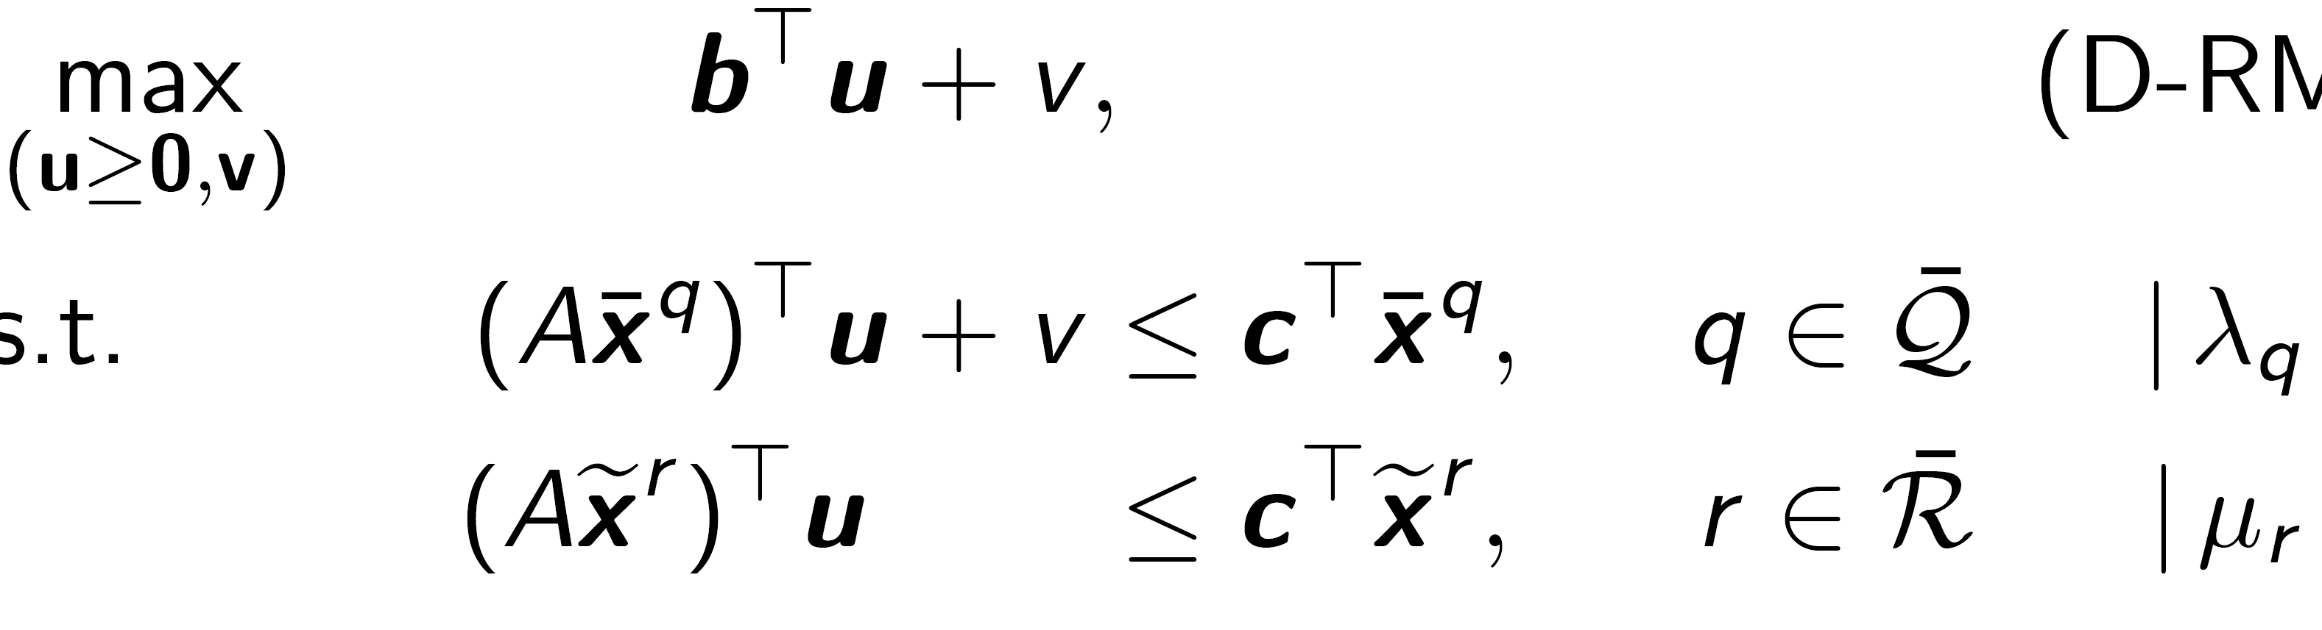
Dantzig-Wolfe (DW) Decomposition
Unbounded LP Formulation
Restricted Master Problem DW Reformulation
Consider the following unbounded LP problem.
From the Representation Theorem, any feasible point can be obtained by a convex combination.
Can obtain the master problem DW reformulation.
Here we have:
A convex combination of extreme points .
A conic combination of extreme rays .
The reformulation has fewer constraints but many more variables.
The restricted master problem (RMP) is obtained by dropping all but a subset of columns and .
Given the dual variables, the dual of the LP restricted master problem can be obtained.
Convex combination
s.t.
s.t.
Dual of the LP Restricted Master Problem
s.t.
Daniel Zuniga
Dantzig-Wolfe Decomposition
Sep. 19, 2021 Slide 19 of .
21

Slide 20
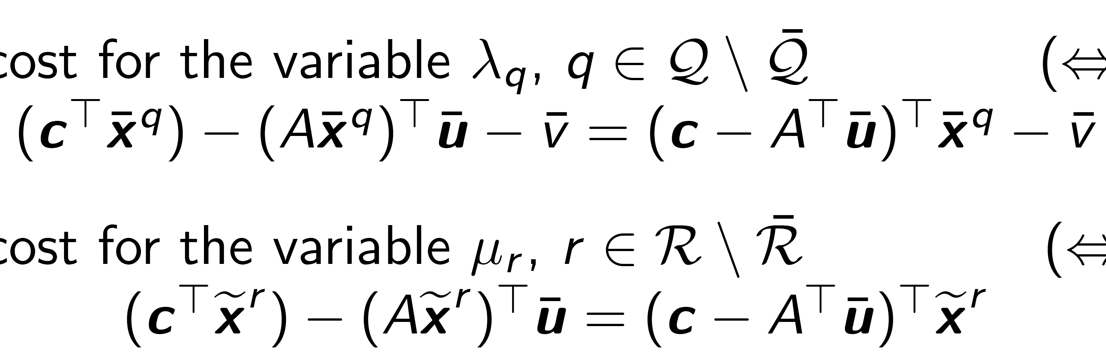
Dantzig-Wolfe (DW) Decomposition
Unbounded LP Formulation
Restricted Master Problem DW Reformulation
Consider the following unbounded LP problem.
From the Representation Theorem, any feasible point can be obtained by a convex combination.
Can obtain the master problem DW reformulation.
Here we have:
A convex combination of extreme points .
A conic combination of extreme rays .
The reformulation has fewer constraints but many more variables.
The restricted master problem (RMP) is obtained by dropping all but a subset of columns and .
Given the dual variables, the dual of the LP restricted master problem can be obtained.
Due to the Simplex Method, we need to find the most negative reduced cost (incoming column).
Convex combination
s.t.
s.t.
Dual of the LP Restricted Master Problem
s.t.
Most Negative Reduced Cost
Reduced cost for the variable
Reduced cost for the variable
Daniel Zuniga
Dantzig-Wolfe Decomposition
Sep. 19, 2021 Slide 20 of .
21

Slide 21
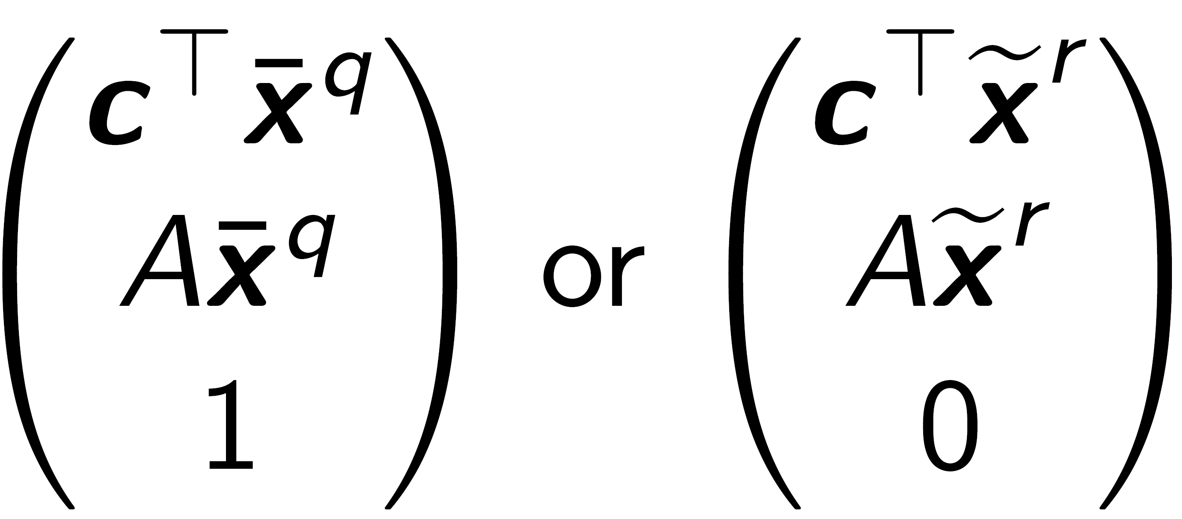
Dantzig-Wolfe (DW) Decomposition
Unbounded LP Formulation
Restricted Master Problem DW Reformulation
Consider the following unbounded LP problem.
From the Representation Theorem, any feasible point can be obtained by a convex combination.
Can obtain the master problem DW reformulation.
Here we have:
A convex combination of extreme points .
A conic combination of extreme rays .
The reformulation has fewer constraints but many more variables.
The restricted master problem (RMP) is obtained by dropping all but a subset of columns and .
Given the dual variables, the dual of the LP restricted master problem can be obtained.
Due to the Simplex Method, we need to find the most negative reduced cost (incoming column).
If reduced cost ≥ 0
If optimal solution is integer, we are done.
Else add new column
Convex combination
s.t.
s.t.
Dual of the LP Restricted Master Problem
s.t.
Most Negative Reduced Cost
Reduced cost for the variable
Reduced cost for the variable
New Column to be added
Daniel Zuniga
Dantzig-Wolfe Decomposition
Sep. 19, 2021 Slide 21 of .
21

